Slide 1
Achieving Leaner, More Agile Government
Going Digital with Drupal and Acquia
Scott Davis – Director of Solutions Architecture
Rick Vugteveen – Solutions Architect
Greg Drapeau – Regional Manager

Slide 2
Agenda
Drupal + Acquia Overview
Open Source Business Model
Drupal in the Government
Drupal In-Depth
Architecture
Features
Mobile
Scalability
Security and Compliance
Acquia Network Demo
Question and Answer

Slide 3
Drupal Overview
Notes:
key additional information about OO and Drupal: http://drupal.org/node/547518

Slide 4



Drupal is Changing the Web
Open source, social publishing phenomenon.
Market Size [ 2,000,000+ sites ]
Innovation [ 18,000+ modules ]
Community [ 1,000,000+ members ]
“… is as much a Social Software platform as it is a web content management system.”
Real Story Group, The Web CMS Report 2010
Notes:
Worth noting 20% of top 10k sites. Largest true CMS, largest presence in government.

Slide 5
Because Drupal is...
Open source GPL technology
Modular, open architecture
Content management system
Community enabled
Enterprise scalable and secure
... there are a lot of [business] benefits!
[Lower costs]
[Open] platform
Rapid [innovation]
[Scalable] deployments
[Repeatable] infrastructure

Slide 6
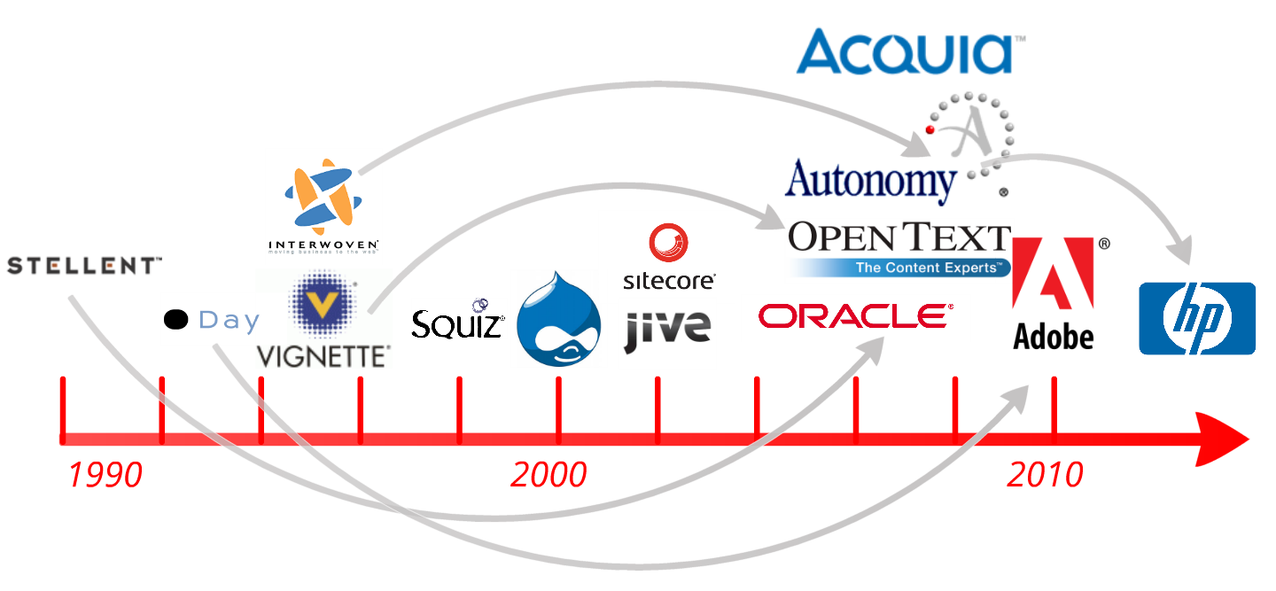
2001 – Drupal Released
Notes:
To set the stage, a brief history lesson is in order… the year is now 1990. As more and more is demanded from web sites - beyond static HTML, early homegrown applications originally used to maintain them quickly become outdated - and give rise to productized "Web Content Management (WCM)" software companies.
However, it's during this same period of time that Open Source moves into the mainstream, leading to the formation of nimble projects such as Drupal in 2000 - and ultimately, Acquia in 2007. Today, in a fashion similar to the early 90s, WCM applications used to maintain web sites have again become outdated - and are giving rise to productized "Web Experience Management (WEM)" software companies. While the definition (and name) of this is still changing, it's clear that the battle is beginning again, and that Drupal is positioned nicely due to both its heritage - as well as it's design.

Slide 7





















2011 – Bossie Awards

Slide 8
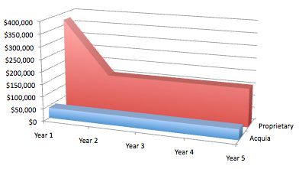
Business Value – Open Source
Cost differences:
No upfront license fee
Subscription based model
Explicitly places the burden of (re)proving a solution’s value onto the vendor – where it belongs.
Shift that proprietary vendors literally cannot afford.

Slide 9













Acquia is the Enterprise Guide to Drupal
220% 3 year CAGR
2400+ customers
280 employees
Global:
Boston, London, Portland, Washington DC, Paris
$68.5M raised capital:
North Bridge Venture Partners, Sigma Partners, Tenaya Capital
Named the #1 Software Company in the Inc.500
Partners
Customers
Awards
Notes:
CAGR = Compound Annual Growth Rate

Slide 10

Multiple Paths to Drupal Success
1
Advise
2
Advise, Architect
& Validate
3
Advise, Architect
& Deliver
Acquia role
Training
Development support
Maintenance
Customer role
Site planning
Architecture design
Project management
Site development
Testing
Deployment
Acquia role
Training
Site planning
Architecture design
Development support
Code validation
Maintenance
Customer role
Project management
Site development
Testing
Deployment
Acquia role
Training
Site planning
Architecture design
Project management
Build to specification
Development support
Testing
Deployment
Maintenance
Customer role
Focus on business goals
Support & maintenance
Network services
Cloud deployment
Developer tools
Drupal monitoring
Performance testing

Slide 11























Acquia Customers
Media
Entertainment
Public Sector
Higher Ed
PROPRIETARY AND CONFIDENTIAL - do not redistribute

Slide 12

Business Value – Acquia
“Nous ne vous laisserons pas échouer”
“We will not let you fail”

Slide 13
Drupal in the Government
Notes:
key additional information about OO and Drupal: http://drupal.org/node/547518

Slide 14
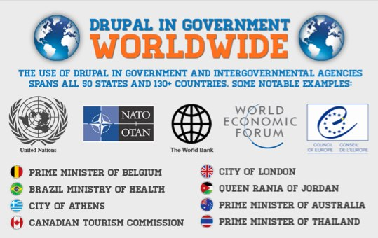
Drupal Adoption in Government

Slide 15
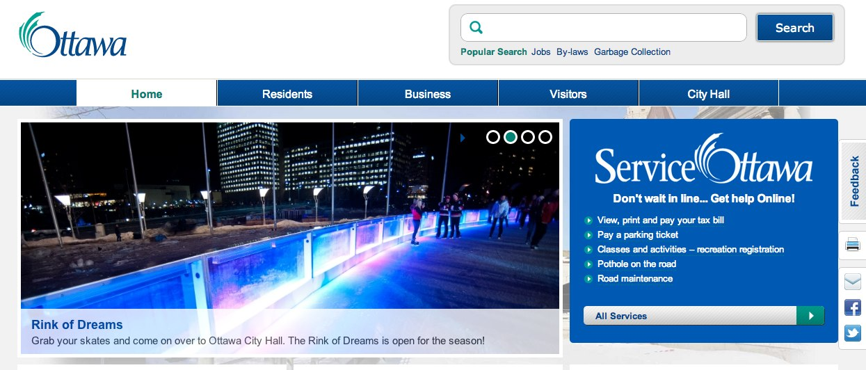
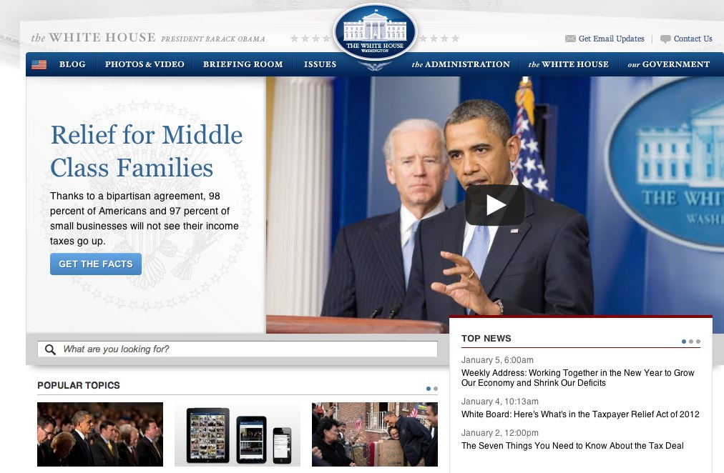
Drupal Government Sites (to name a few)
Ottawa.ca
Ontario.ca
Buyandsell.gc.ca
Whitehouse.gov
Energy.gov
Commerce.gov
Education.gov
DHS.gov

Slide 16
Examples: Consolidation, DHS - FEMA
Challenge
17 websites and domains for emergency monitoring, notification, management and resolution
Multiple system integrators maintaining individual sites
Sites ran across variety of platforms: Interwoven Teamsite most dominant
Solution
Drupal, Acquia, Phase 2
Consolidated to 3 sites/domains (ready.gov, disasterassistance.gov, FEMA.gov)
Launched in public cloud
Millions of dollars/year in cost savings from labor and software licensing

Slide 17
Platform Investment vs Site Cost
Return on investment achieved very quickly
Individual site costs vary depending on complexities of each site

Slide 18
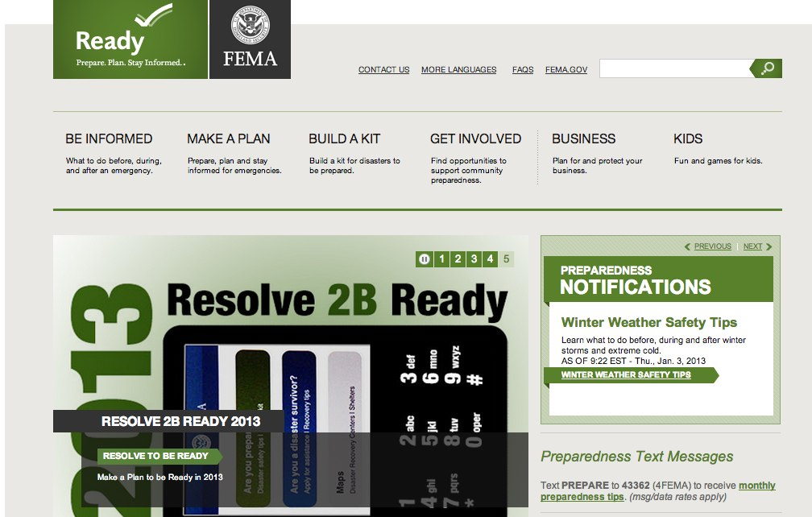

Slide 19
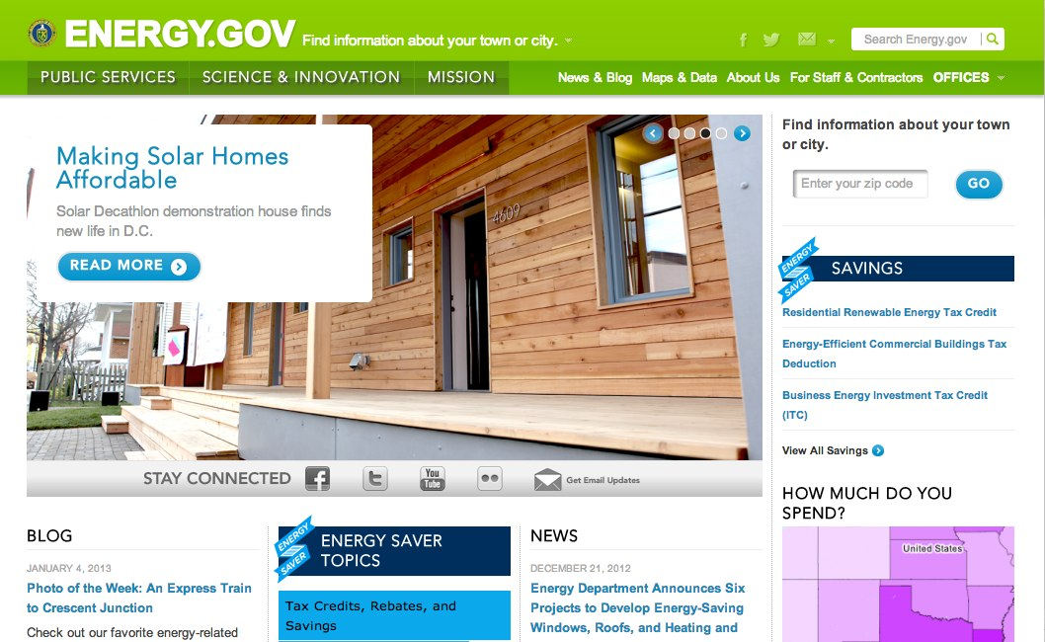

Slide 20
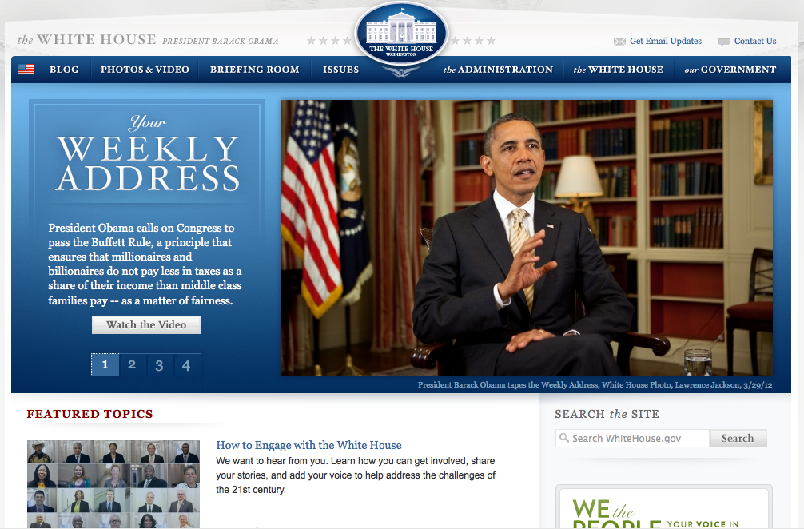
http://www.whitehouse.gov/

Slide 21
Drupal in Depth
Notes:
key additional information about OO and Drupal: http://drupal.org/node/547518

Slide 22

It’s All About the Modules
Drupal “Core” Modules
Drupal “Community” Modules
Module Extending
Notes:
Drupal is composed of functional components known as modules, and was designed from the get-go to support great extensibility. In fact, the Drupal community regularly “absorbs” contributed modules (created on top of CORE Drupal), making them part of Drupal’s next major platform release.
Innovation in the Drupal community works like this:
Individual community members identify new functional requirements for their Drupal sites, typically based on their own needs. He or she develop and contribute a new module to the project based on those needs.
If others share this requirement, they will investigate and use the module, often contributing patches and bug fixes, along with new capabilities, to improve the module.
The more popular a module becomes, the faster it improves in quality - to the benefit of everyone who uses it.
If a module becomes popular, or valuable enough, it may be considered for inclusion in a future release of Drupal core.
This virtuous cycle of informal, networked collaboration is what drives innovation in the Drupal community, and on the web.
Drupal core consists of approx. 30 such modules, which have been created, managed, and maintained by approx 800 community contributors.
On top of Drupal core, there are at this time over 7,000 contributed modules -- from approx. 5000 contributors.
Drupal.org hosts a testing environment with over 30,000 test to ensure the stability of core and contributed modules
And Drupal is designed around a hook system which makes it possible for your developers to “override” module behavior to meet your organizations custom needs.

Slide 23


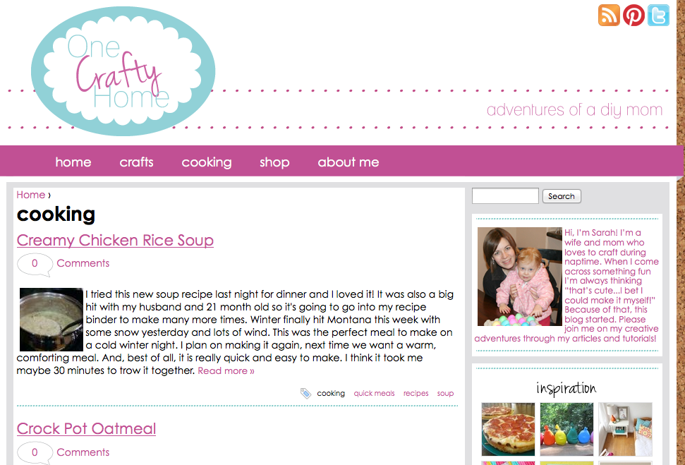



Truly Agile Open Source Development
February 2012
March 2012
April 2012
Pinterest hits
10M unique visitors
New Drupal module created for website Users “pinned” images
15 Drupal sites go live with Pinterest integration

Slide 24
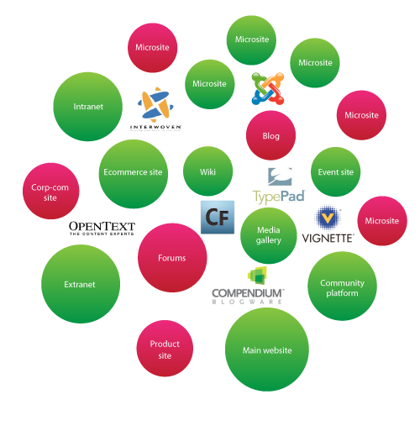



Inside Many Large Organizations, the Web Is Broken
Duplication of content
Disparate sources
Disconnected reporting
Islands of excellence
Notes:
Interwoven now HP

Slide 25
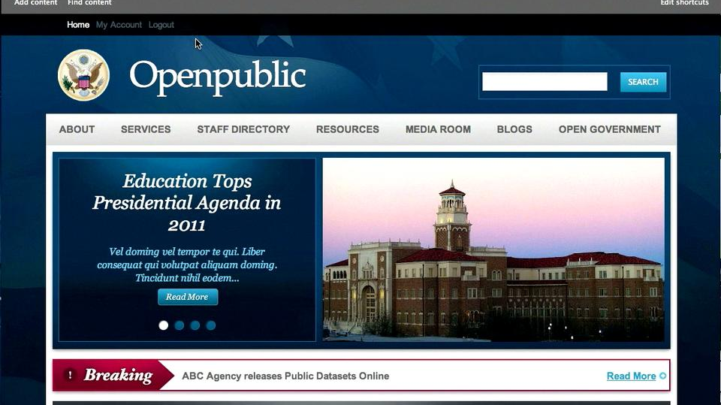
Distribution: OpenPublic

Slide 26
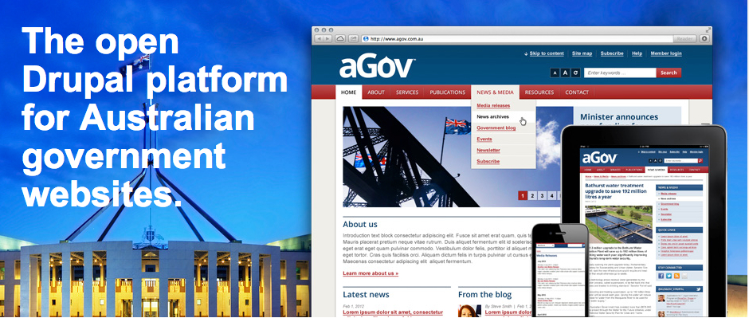
Distribution: aGov

Slide 27
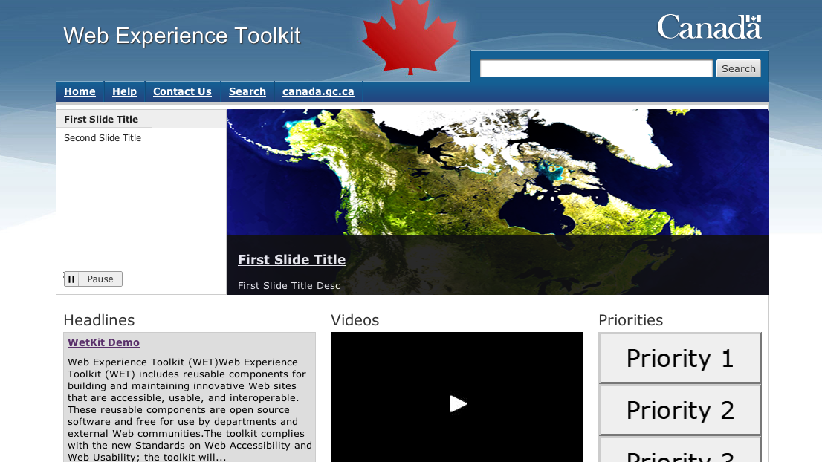
Distribution: Web Experience Toolkit
Notes:
(built by OpenConcept and OpenPlus)

Slide 28
Drupal Architecture
Notes:
key additional information about OO and Drupal: http://drupal.org/node/547518

Slide 29
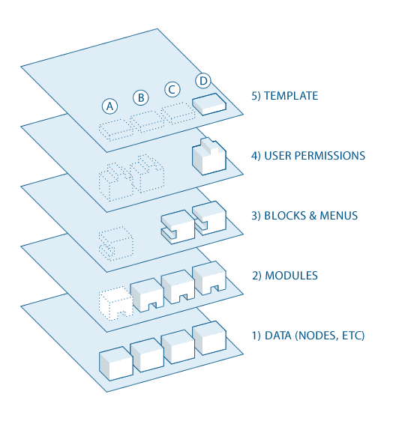
Notes:
Layers of Drupal’s architecture

Slide 30
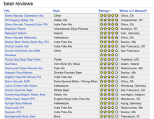
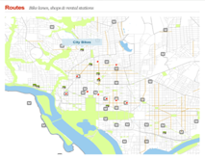
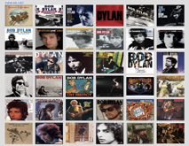












How Drupal Manages Content
Views
References
Content
blog post
wiki entry
web page
video
image
media
Nodes
© 2010 Acquia, Inc. All rights reserved.
© 2009 Acquia, Inc.
Notes:
[This slide builds]
Core to Drupal’s success since the project’s first release in 2001 has been an extremely elegant information architecture. Drupal manages information of all kinds in the form of “nodes.” Content on Drupal sites are almost always composed of multiple “nodes,” e.g.:
a product description - text
a product image - jpeg file
related product catalog information
Because these atomic elements are managed separately by Drupal, site developers can assemble them in many ways and generate new user experiences easily.
Administrators can also create custom content types -- to supplement a raw node with information which makes the content useful and meaningful to people.
---
Raw nodes including text content can become “blog posts,” for example, by including information identifying the author, and a date for publication. A node including a reference to an MP3 file can be converted into an “album tracks” with the inclusion of information identifying the artist, the title, the producer, and the date of publication.
---
Content in Drupal can be “referenced.” Examples: Users can create a comment, which is associated with a specific blog post; or they can add a vote or a tag to a product description page. As we will see in a moment, this type of content is used in conjunction with roles and permissions to enable a broad range of social publishing capabilities.
---
Finally, Drupal gives site designers and administrators great flexibility over how site content is presented to users through “views.” Views provide a powerful capability to query content stored in Drupal nodes, and to present that content to users in meaningful ways. Views can be used to do everything from creating simple, reverse-chronological lists of blog post titles, to creating a rich display of music track thumbnails ordered by average “star rating” based on user voting, to RSS feeds, navigational blocks and much more.

Slide 31






How Drupal Manages Users
Administrator
Authenticated Users
Anonymous
Users
Roles
authors
editors
Groups of like users
Permissions
Create Page
Edit Page
Operations allowed by role
Views
My Posts
All Posts
Determined by permissions
Notes:
[this slide builds]
Drupal provides an elegant user management framework which makes new, interesting types of social engagement on the web possible.
---
Users can be “anonymous,” or they can have a profile on a Drupal site and become authenticated users. Authenticated users can be organized into groups, known as roles. As a simple example, anonymous users might be plain readers of public content on a Drupal site, while users in the “authors” role might be able to create new pages or blog posts on the site. Another group of users might be “editors.”
---
Author permissions might only grant users with that role access to public content, plus the pages or posts they have themselves created.
---
Editors, on the other hand, might have permissions giving them access to see all contributed pages and posts, and to update the content of those pages and posts. Furthermore, perhaps only editors have the right to set a custom field like “publication time,” which would specify when the content would go live on the web site.
---
All of these are configurable by the site administrator, and completely customizable.
The ability to create custom roles, and to define very specific access control permissions based on those roles, makes great social sites possible. It is simple to define a role such as “Visitor.” Visitors would like to comment on blog posts -- so they create a Drupal log-in, but that role’s permissions may give them only the right to add comments to blog posts. “Customers” might be granted a different custom role, which would entitle them to add content ratings to product pages. These ratings might be visible to “Product Managers,” but invisible to “Visitors.”
Suddenly very rich interactive experiences can be offered to visitors, all in accordance with the access appropriate to them individually.

Slide 32
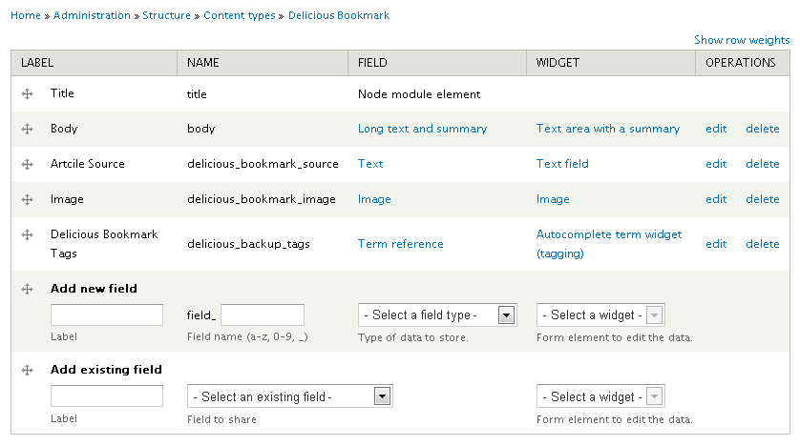
Field API

Slide 33










Developers: Open Data, Open Standards
Open standards support:
Media Asset Management
Application integration
User access & authentication

Slide 34
Sample Features
Notes:
key additional information about OO and Drupal: http://drupal.org/node/547518

Slide 35
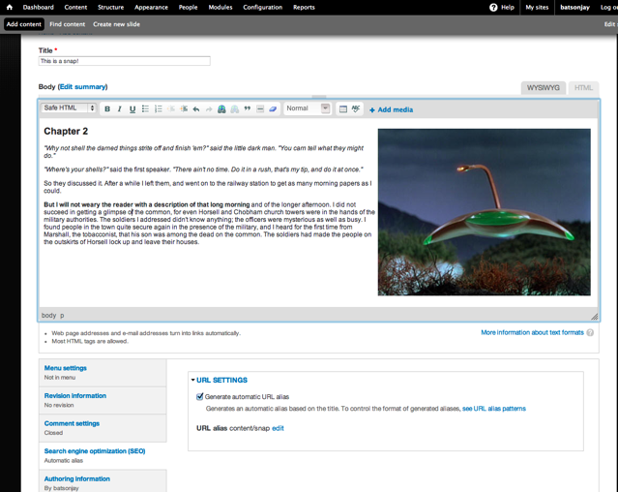
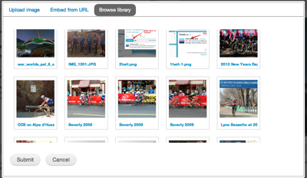
Content Authoring
WYSIWYG editing
Content & presentation separation
Rich media integration & controls
Drag and drop page layouts

Slide 36
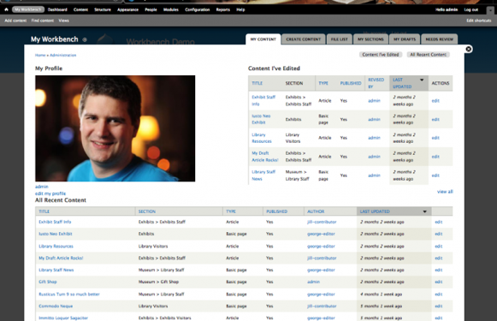
Editorial Workflows
Content creator / editor workbench
Review, approval, publishing workflows
Change reviewing
Content versioning
Role-based interface & permissions

Slide 37
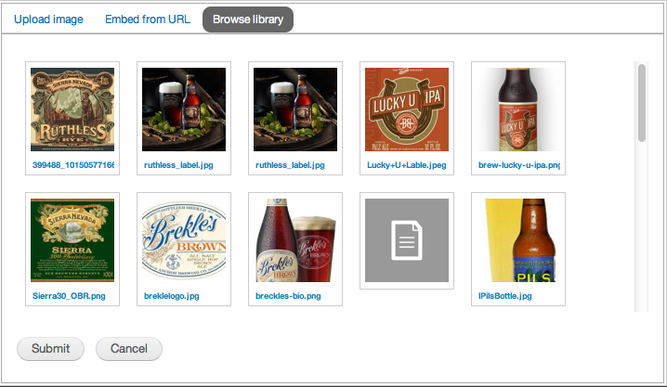
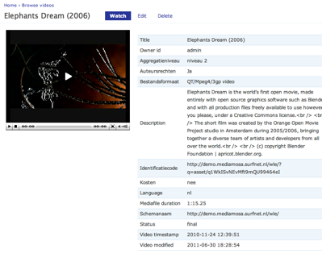
Integrated Rich Media Management
An Acquia SaaS feature service
Centralized media repository for multi-site
Integrates directly into Drupal content / media UI
Tagging & metadata
Searching & previewing
Digital Rights Management

Slide 38
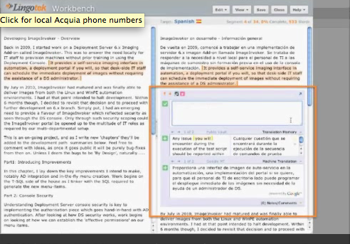
Language Translation and Multi-Site
Multilingual content
Support for handling text content, fields, variables, UGC, …
Language translation workflow
Localized Drupal UX
Core, custom code
Core Drupal, or Lingotek
Single site and multisite

Slide 39
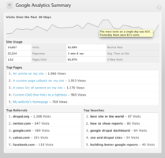
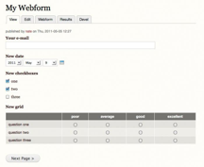
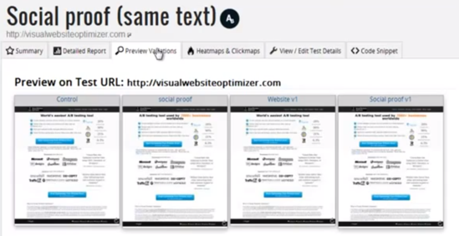
Analytics and Reporting
Analytics agnostic - web, marketing & social
Marketing automation agnostic
User / role-based data
Point and click webforms for landing pages
Search/solr integration

Slide 40
Mobile and Multi Platform
Notes:
key additional information about OO and Drupal: http://drupal.org/node/547518

Slide 41
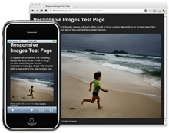
Responsive design
Recommended use cases
Blogs, marketing, event sites.
Targeting wide variety of devices with the same content and assets. Best for desktop and tablets.
Accommodate the widest variety of contexts.
Able to redesign site from ground-up.
Not recommended for
Sites with many “regions” or “blocks” of content.
Very low-bandwidth delivery requirements.
App development.
Notes:
Forrester 2012: Take an “automate and optimize” [responsive] approach, device detection does not scale.
Drupal offers the flexibility for hybrid responsive design templates out of the box as well as REST APIs for pushing data to native applications.

Slide 42
Multichannel publishing

Slide 43
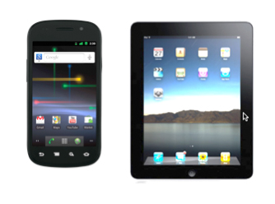









Drupal Delivers Rich, Integrated Experiences
Microsite
Intranet
Corp-com site
Microsite
Main Website
Product Site
Community Platform
Main Website
Notes:
With that, Drupal is emerging as a new standard for managing integrated customer experiences. Drupal was born 10 years ago as a social publishing tool, and quickly evolved to become a robust web development platform that covers the full gamut of content, community, and commerce experiences. It has an architecture that allows it to treat content as individual objects that can be delivered in whatever context you choose, and has a flexible front end that lets it output to one or many distinct web experiences. You see drupal used as often for headless experiences where it is simply feeding applications and rich media as you see it being used for traditional web experiences.

Slide 44
Scaling Drupal
Notes:
key additional information about OO and Drupal: http://drupal.org/node/547518

Slide 45

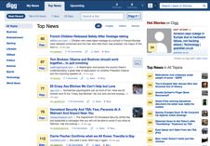
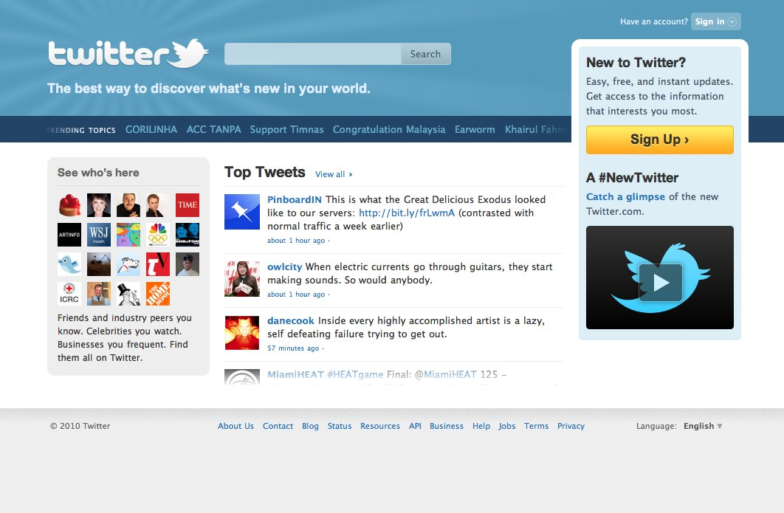

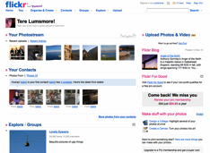
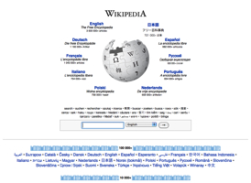
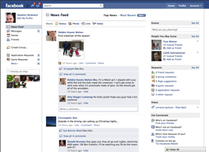
Runs on LAMP...
...like the web’s busiest sites
Linux
Apache
MySQL
PHP
© 2009 Acquia, Inc.
Notes:
Many of the web’s largest and highest-traffic web sites are built on a standards-based stack known as the LAMP stack. The LAMP stack has emerged as the defacto platform standard for dynamic web applications and is powering the world’s largest, highest traffic websites - including Facebook, Wikipedia, Yahoo, Twitter, and many many more.

Slide 46
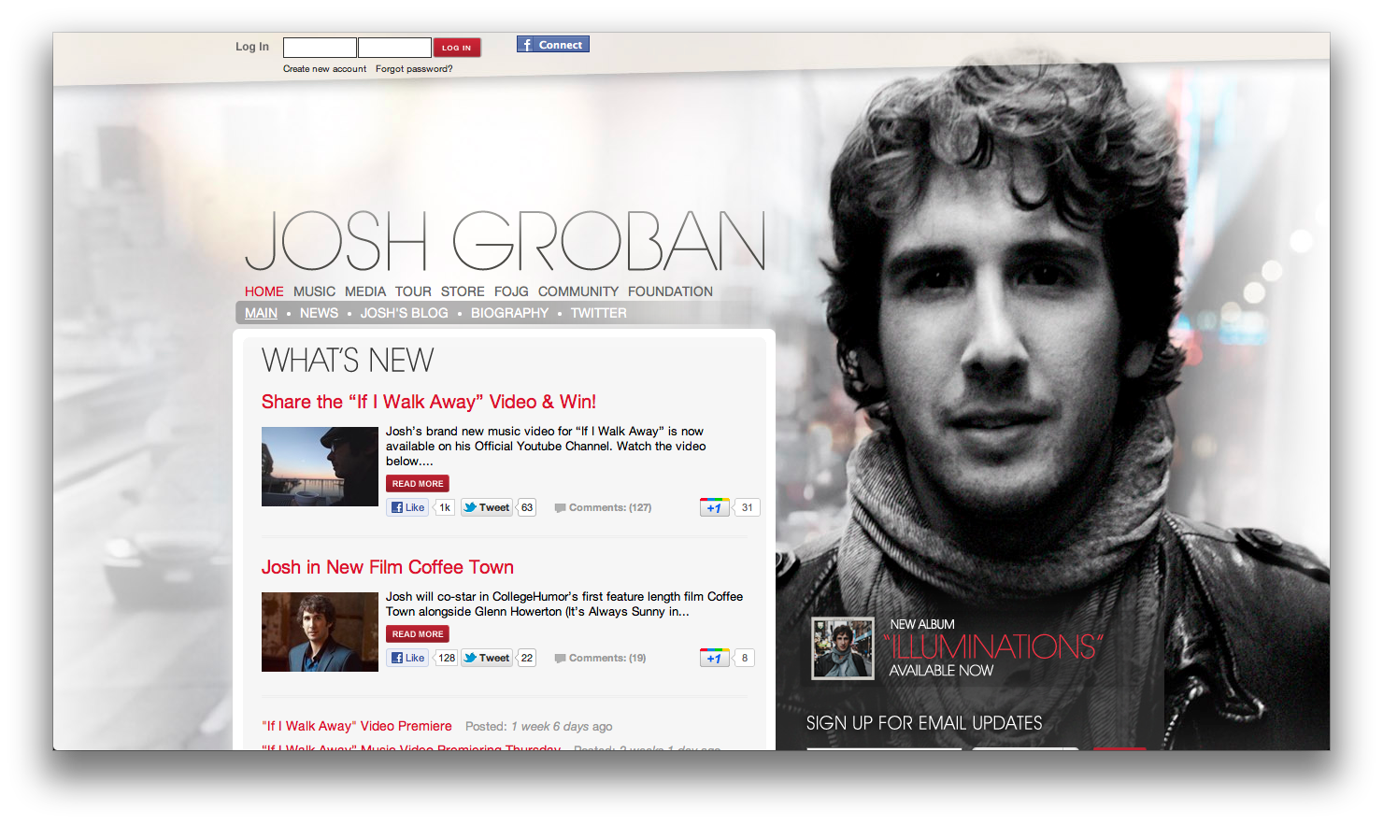
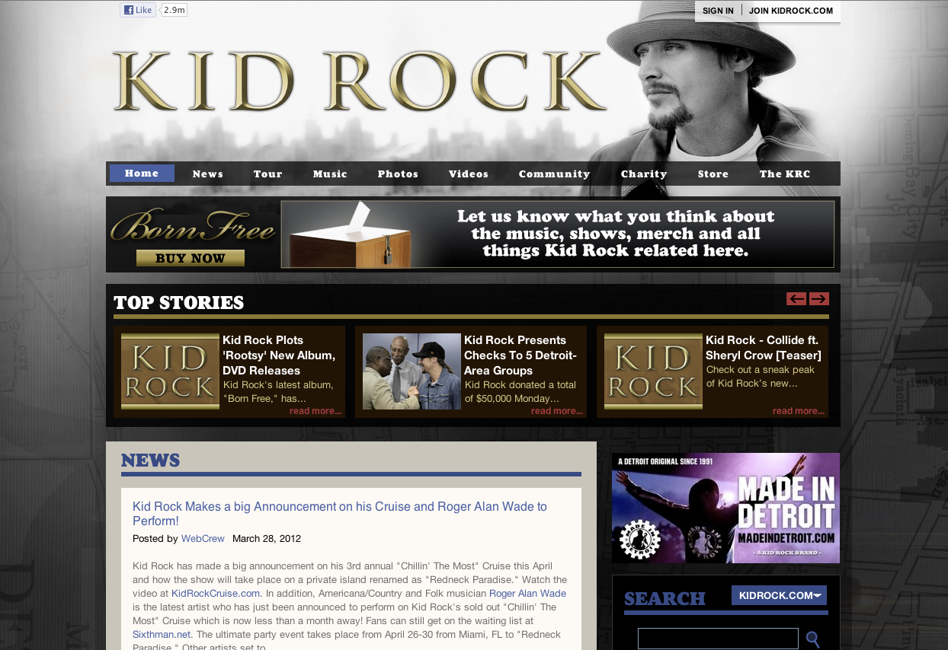
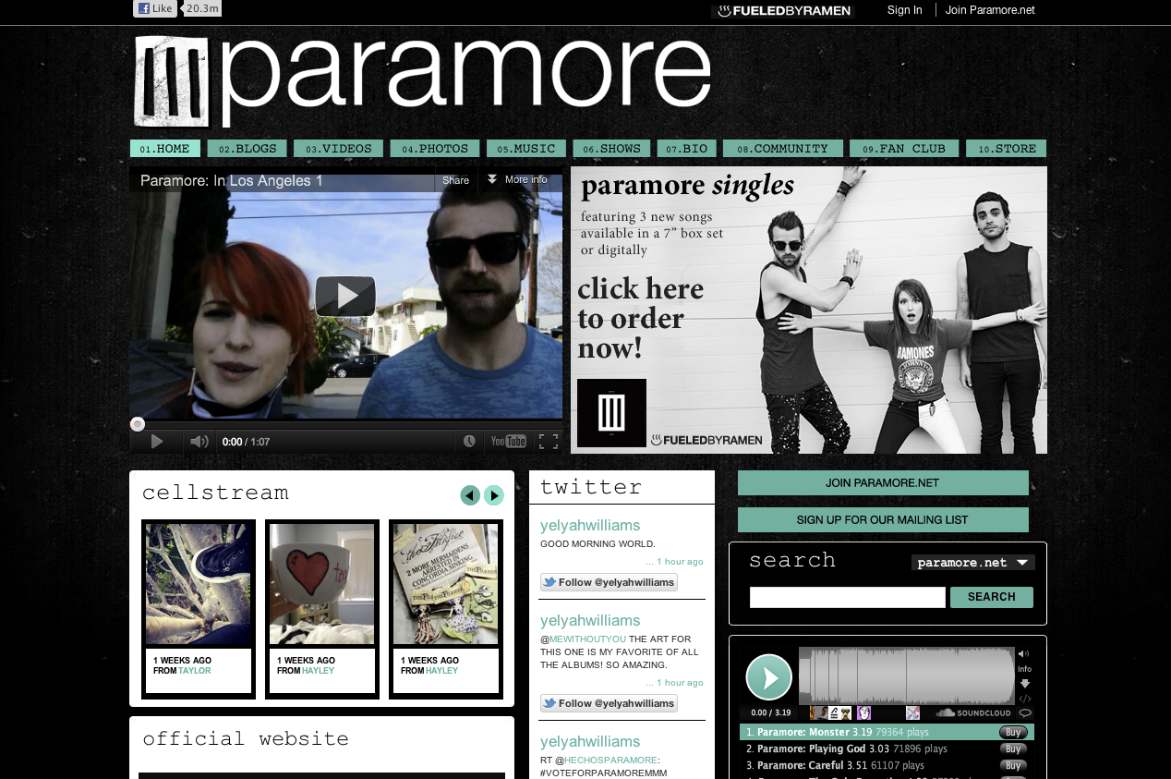
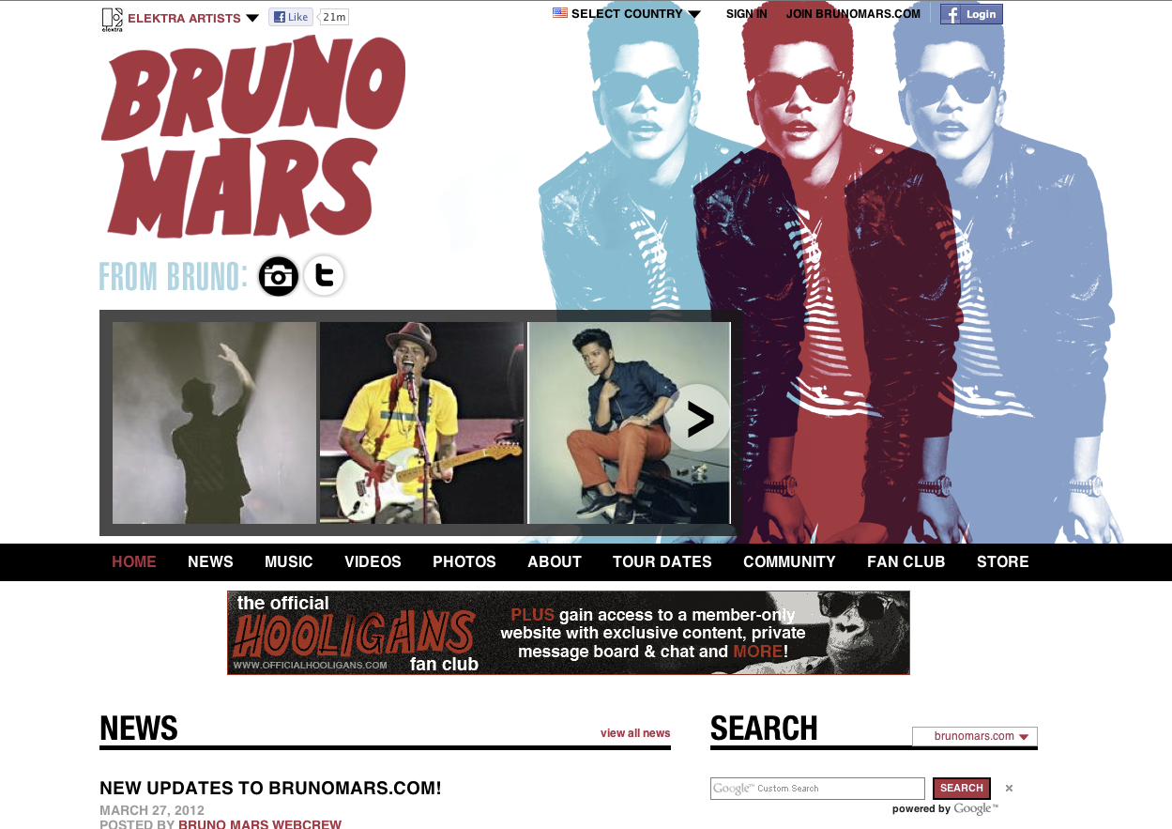
Warner Music Group
140 sites on Acquia Managed Cloud
Complex e-commerce workflow requiring registration, search, checkout
Call-to-action from unpredictable promos drives thousands of simultaneous responses
Have experienced 90M requests in one day

Slide 47
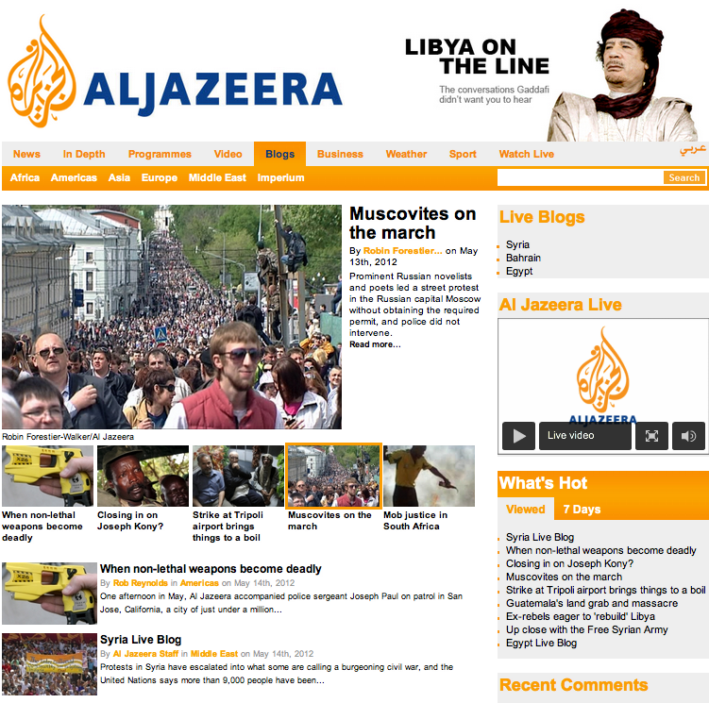
Al Jazeera blogs
4 sites on Acquia Managed Cloud
20M page views in a day
50M requests
380M page views per month

Slide 48

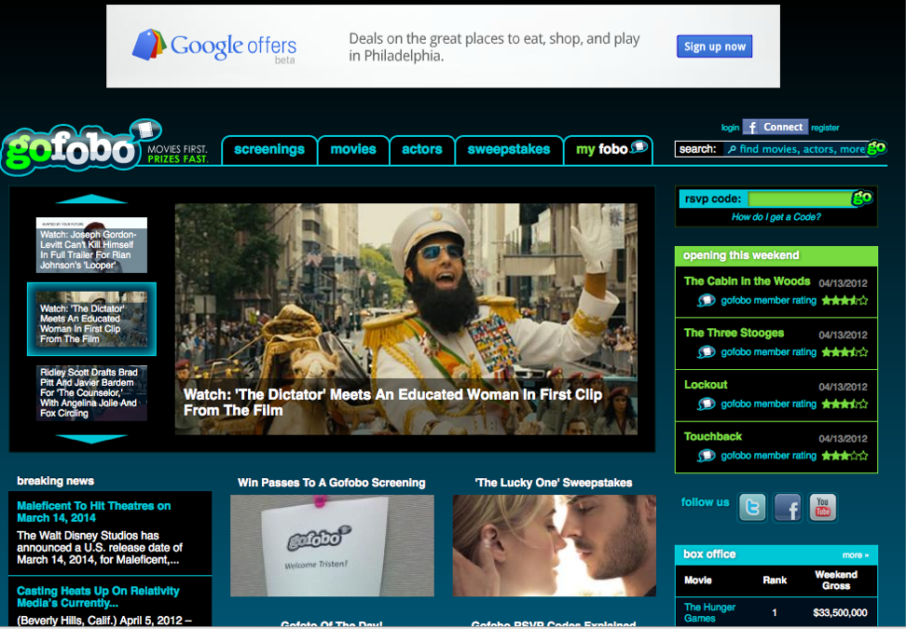
Gofobo
Start-up business
Frequently experience traffic spikes without notice
Even when they do have notice – i.e. Good Morning America promotion – they don’t have the expertise to know how to scale their environment
Have experienced 7,500 concurrent users in one day
Notes:
, the largest young men’s lifestyle magazine in America reaching nearly 11 million readers each month
Maxim Digital encompasses Maxim.com and Maxim digital editions, reaching almost 5 million unique visitors each month
“We had no organizational agility” he said.
With significant dollars invested in the proprietary CMS, the new CTO had to make a compelling business case to throw that investment out, re-platform to Drupal, hire Drupal developers, and move to Acquia’s hosting environment.
Through business sponsorship, the project was approved, and the rebranded
Maxim.com launched one day ahead of schedule, on a tight three month timeframe.
Results & Benefits
60% cost savings in infrastructure costs.
Re-platformed to Drupal and gained the flexibility the business required.
They re-tooled their developers in short time thanks to Acquia Professional Services onsite training.
Built the site from scratch and migrated into Acquia’s cloud all in a three month timeframe.

Slide 49
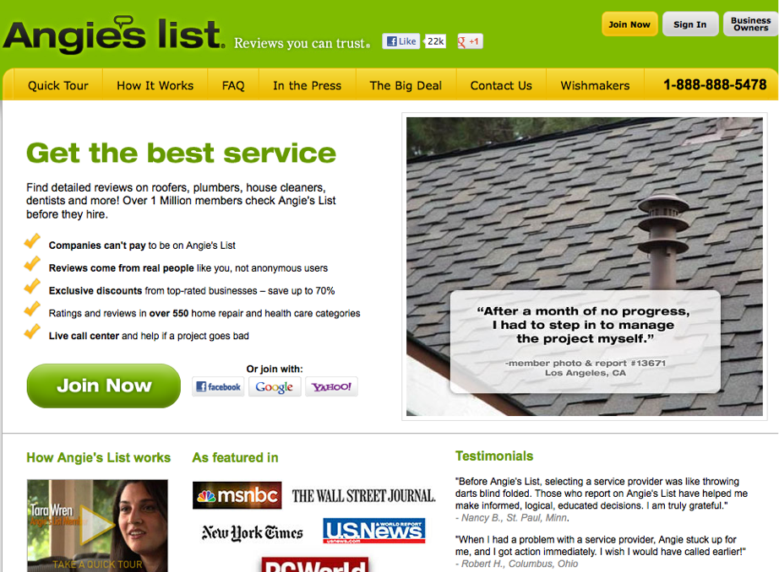
Angie’s list
Have experienced 90M requests in one day

Slide 50

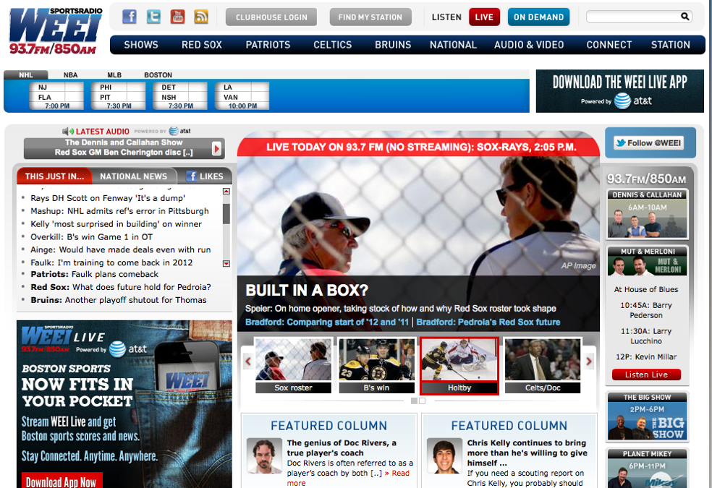

WEEI Sports Radio
Have experienced 42M requests in one day

Slide 51
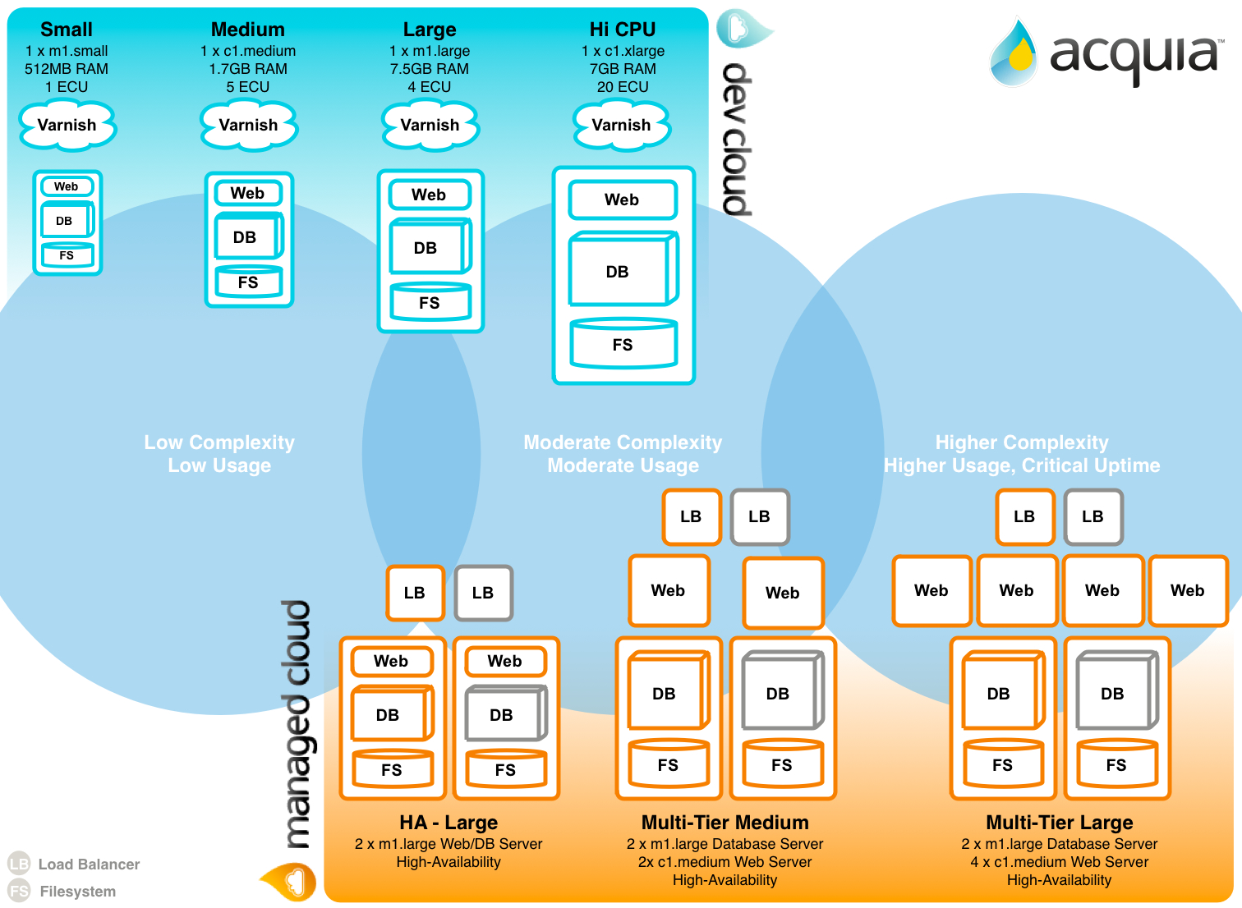
Notes:
Architecture
Dev cloud
Different levels of managed cloud
Varnish, NGinx
web server, PHP, Opcode cache (APC), Memcache
Database – Percona 5.5
Network file system - Gluster

Slide 52
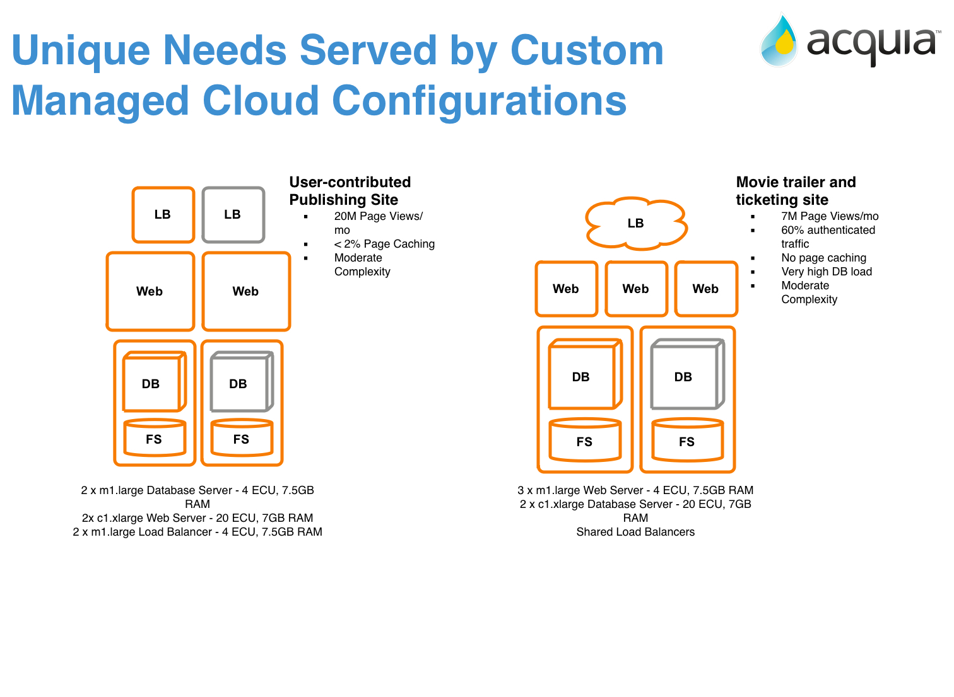
Notes:
Unique Needs Served by Custom Manged Cloud Configurations
Different kinds of confiurations for the different types of workloads
Different usage contexts
Differentiate from Pantheon,
diff workflows require diff combinations
Elastic and customizable resources customized for your need
GoFOBO and WMG - dedicated memcache servers
Shibboleth, OpenSAML authenticate against infrastructure
Multi-region
Region selection
CPU, Mem, Memcache, Database side

Slide 53
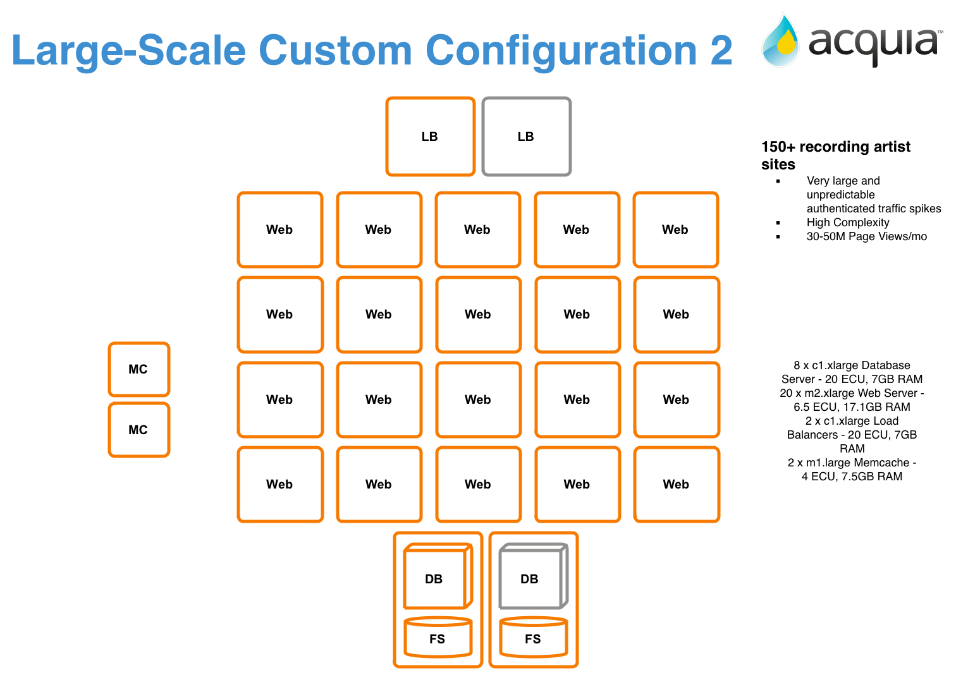

Slide 54
Scaling your site - onboarding
Trusted code base
Content Delivery Network integration
Agree on load testing methodology and unambiguous metrics
Onboard code base on infrastructure
Scaling infrastructure
Support for application server load balancing without the need for sticky sessions
Support for memcached and other high performance object stores
Multiple internal and external caching schemes
Support for ESI, extensive OOTB AJAX support
Support for read slaves (on Acquia Managed Cloud roadmap, but supported by Drupal)
Load tests and site audit

Slide 55
Large content sites on Drupal
www.examiner.com – 4.2M
www.economist.com – 1M
www.popsugar.com – 683K
www.hollywoodreporter.com 459K
www.nationalreview.com – 433K
www.akavita.org - 334K
www.people.com - 305K
As Reported by Google

Slide 56
Security and Compliance
Notes:
key additional information about OO and Drupal: http://drupal.org/node/547518

Slide 57

Acquia Security Commitment
Acquia: “Your Enterprise guide to Drupal”
Support & Managed Cloud: “We will not let you fail”
Michael Lemire
Director, Information Security

Slide 58
Acquia Certification and compliance
FISMA Moderate
DIACAP
FedRAMP
HIPAA
ISO 27001
SAS70/SSAE16
PCI DSS
https://www.acquia.com/resources/collateral/secure-compliant-cloud-hosting-government-drupal-sites
https://www.acquia.com/collateral/acquia-cloud-security-and-compliance

Slide 59

Security in the Drupal Community
Drupal security team has 35 members
Regularly published security advisories
Responsible for Drupal Core and Contrib
Open Web Application Security Project
Top Ten Vulnerabilities: Audited & Passed
Proof point: www.whitehouse.gov
More info: drupalsecurityreport.org
Notes:
To ensure that Drupal meets the highest standards for web application security on an ongoing basisc, the Drupal project has a security team of 35 active members. Over the years, this team has continually strengthened Drupal’s core APIs by managing a disciplined process of testing and peer review of code, as well as the distribution of security advisories to the Drupal community. These advisories include, as appropriate, patches to modules, updated versions, or instructions on how to mitigate the security risk (temporary workarounds).
The Drupal Security Report details how the Drupal project addresses web application security with their “Top Ten Most Critical Web Application Security Risks” including Injection, Cross-site Scripting (XSS) and others.
---

Slide 60
Drupal compliance and accreditation
NIST-FISMA
DIACAP
Section 508
WCAG 2.0 and ATAG 2.0
WAI-ARIA
W3C validation (XHTML, HTML5)
Strong commitment to open web standards

Slide 61




Infrastructure controls & procedures
Physical controls – Builds on AWS SAS70 Type II control set
Logical controls – Built on AWS and Acquia’s process documentation
Logging and access controls – Built by Acquia, accessible and archivable by customer
Managed Cloud customers include:
https://docs.acquia.com/cloud/architecture

